Slide 1
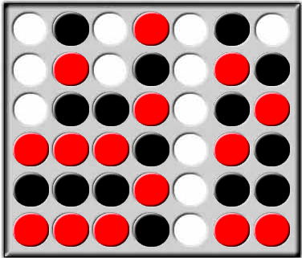
Connect 4 AI Player
Ming Wu

Slide 2
Background
Existing Games With Perfect AI Player
Mustrum (win32), Velena (ms-dos), TitOT
The game was solved mathematically by James D. Allen (1 October 1988), and independently by Victor Allis (16 October 1988)

Slide 3
Algorithms
  Minimax Game Tree Search
  Alpha Beta Pruning
  Heuristic Evaluation Functions
Evaluations
  Human vs AI Player
  AI Player vs AI Player

Slide 4
Heuristic Evaluation Functions
Unique Properties of Connect 4
  Start of the game is important
  Good threat is created in the first half of the game
  End game easy to play
  First player (black) has advantage
  Known good play strategies and rules
  Victor Allis: “A Knowledge-based Approach of Connect-Four” ( Oct 1988)

Slide 5
Heuristic Evaluation Functions
Features
  A row is defined by 4 slots adjacent to each other horizontally, vertically or diagonally
  2 pieces in a row
  3 pieces in a row
  Odd Threat
  Event Threat

Slide 6
Heuristic Evaluation Functions
Score Calculation
  Check game board for every possible combination of 4 in a rows
  Number of combinations 69
  Evaluate the move by calculate the score for the board with the move
  For Player One Move
    Scroe = PlayerOneStrength – PlayerTwoStrength
  For Player Two Move
    Scroe = PlayerTwoStrength - PlayerOneStrength

Slide 7
Heuristic Evaluation Functions
Score Calculation
    Player One Strength (Black) =
        PlayerOne.3InARow.Odd * 32 +
        PlayerOne.3InARow.Even * 16 +
        PlayerOne.2InARow * 4 +
        PlayerOne.1InARow * 1
    Player Two Strength (Red) =
        PlayerTwo.3InARow.Even * 32 +
        PlayerTwo.3InARow.Odd * 16 +
        PlayerTwo.2InARow * 4 +
        PlayerTwo.1InARow * 1

Slide 8
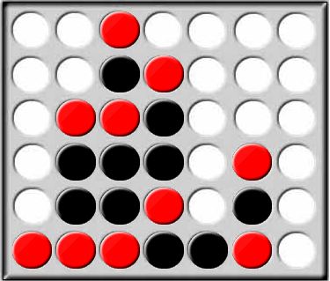
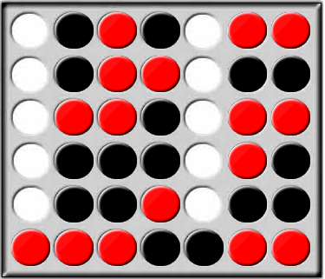
Heuristic Evaluation Functions
  Not all “3 pieces in a row” are the same
  Odd Threats for First Player (Black)

Slide 9
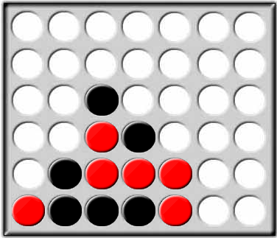
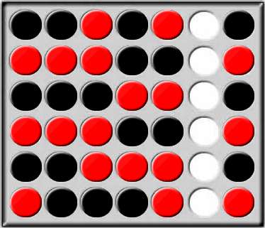
Heuristic Evaluation Functions
  Not all “3 pieces in a row” are the same
  Odd Threats for First Player (Black)
  Even Threats for Second Player (Red)

Slide 10
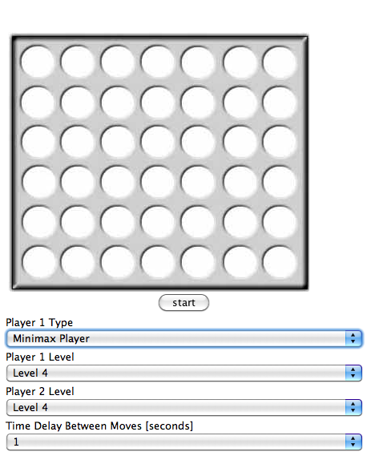
Demo
Reference: http://www.geocities.com/ResearchTriangle/System/3517/C4/C4Conv.html

Slide 11
Evaluation Result
Me vs Minimax AI Player
  AI Player has above average skill
  I am not expert on connect 4
  Hard to find connect 4 expert
Minimax AI Player vs AllPossibleMoves AI Player
  Minimax will beat AllPossibleMoves at search depth 3

